Slide 1
Swing Buttons, Combo Boxes,
File Choosers, Lables, Lists
CS 5100
Lecture 14

Slide 2
Additional Swing beyond AWT
Panes: Editor, Layered, Option, Scroll, Split, Tabbed
Controls: ProgressBar, RadioButton, Slider, ToggleButton, PasswordField, ToolBar
Selection: ColorChooser, ComboBox, List
View: Tree, Viewport
ToolTip
Box

Slide 3
Buttons
States
  enabled
  selected
  rolled over
  set
Text and icons, alignment and position
Mnemonics
setFocusPainted

Slide 4
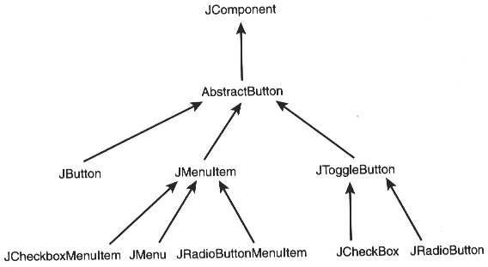

Slide 5
Button Classes
AbstractButton
ToggleButton
Button
CheckBox
RadioBox
MenuItem
  CheckBox
  RadioBox
Menu

Slide 6
ComboBoxes
Single selection with a drop-down list
Editable
Construct from
  model
  array
  vector
add or insert
get or set selected item from software
control the size of the non-scrolled list

Slide 7
File Choosers
Familiar, but complex
Can open, save, or (print, delete, move)?
getApproveButtonText, getDialogType, getDialogTitle
getSelectedFile(s), getName, getDescription
getCurrentDirectory
File selection mode
Filtering
rescanCurrentDirectory

Slide 8
Labels
Text and/or icons
setHorizontalAlignment, setAlignmentX
setHorizontalPosition
setHorizontalTextPosition
Can be associated with (label for) other objects, in which case they have
  mnemonics
  disabled icons

Slide 9
Lists
Can contain all sorts of objects
Selection policies
  single
  range
  multiple range
Find or set selections by object or index
Conversion between indexes and pixels
Set non-scrolled size, make sure a selection is visible, set selection highlight, etc.

